Slide 1
Managing Information Technology Resources ITWS 4310
Machine Learning
Knowledge Management
November 5, 2018

Slide 2
Managing IT Resources Class Outline: Mon, Nov 5, 2018
MITR Term Project
Schedule Meetings with Client and Invite Faculty to Meetings
Work on Design and Development
Draft of Entire Term Project Final Report on Nov 19 by 9 PM
Current Events
Knowledge Management
Machine Learning
Google Case on Thurs, Nov 8, Submit Written Answers prior to class

Slide 3
Randomly Assigned Final Presentation Schedule
Thursday Dec 6
Team 5
Team 2
Team 4
Monday Dec 10
Team 3
Team 1
Team 6
Invite your Clients to attend your class presentation and any or all of the other presentations on the two days.
In Addition, offer to present in a longer format (~ 1 hour) at the Client’s Location or on a Video Link to the Client’s Location.
If your Client cannot attend the day scheduled, but could on the other day, let us know and we will try to accommodate.
Presentations will be 15 minutes long with 5 minutes for Q&A. Time will be monitored and you will be given visual warnings at 3, 2, 1 minutes respectively.

Slide 4
Managing IT Resources: ITWS 4310 Term Project Report Outline
Section 1: Executive Summary
Section 2: Introduction
Section 3: Client Organization and Description
Section 4: Project Team
Section 5: Problem Statement
Section 6: IS/IT Solution
Section 7: Methodology
Section 8: IS/IT Requirements
Section 9: IS/IT Design
Section 10: Cost-Benefit Analysis with (Risk Mgmt)
Section 11: Project Plan/Schedule/Resources
Section 12: Post-Turnover Plan
Section 13: Results and Client Feedback
Section 14: Conclusions
All Sections of Final Report in Draft due by Nov 19 (Mon before Thanksgiving) at 9 PM

Slide 5
Managing IT Resources: ITWS 4310 Term Project Report Outline
Section 1: Executive Summary
Should be able to “stand on its own”
Provides an “executive” overview of the entire project
What are the important points that an executive would need to know?
The best summaries effectively balance details with a concise writing style

Slide 6
Managing IT Resources: ITWS 4310 Term Project Report Outline
Section 2: Introduction
Keep it short – 2-3 sentences
Only 2 objectives: provide a little context for the project and pique interest to read on
Section 3: Client Organization and Description
Give some idea of the size of the organization: number of employees, number of locations, etc.
Include Client Contact name and contact information
Section 6: IS/IT Solution
If solution has changed throughout semester, make reference to the original solution concept and then describe current/latest solution concept
Section 7: Methodology
Brief description of how each major aspect of project was done e.g. a cost benefit analysis focused on NPV and IRR was used to assess financial viability of the project. Don’t’ be repetitive with subject section
Cover project/client selection, requirements, development methodology, financial viability, project management, implementation methodology, and client feedback method

Slide 7
Managing IT Resources: ITWS 4310 Term Project Report Outline
Section 8: IS/IT Requirements
Categorize both Functional and Non-Functional Requirements
Section 9: IS/IT Design and Development
Use-Case Summary (part of narrative) and Use-Case Diagram
Work Flow Diagram (logic that connect back-end with front-end)
Back-end Design including Data Work Flow and Database Design
Front-end Design including Mock-ups, Wireframes, Screen Shots
Working System including link to working system or prototype
Access to Code in Code Repository
Test Plan(s) and Test Results
Narrative of All Design and Development
Section 10: Cost Benefit Analysis with Risk Management
Combine the Excel Sheets for CBA and Risk Management into one Excel Workbook
Combine the CBA and Risk Management into one Narrative

Slide 8
Managing IT Resources: ITWS 4310 Term Project Report Outline
Section 11: Project Management/Resource/Schedule
Specify reference to separate Gantter project plan
Include screenshot showing entire project in report
Summary of major project phases including the duration, work effort, costs for each phase. Can be organized into a summary table
Section 12: Post-Turnover Plan
Installation
Training
Documentation
Future support and maintenance plan

Slide 9
Managing IT Resources: ITWS 4310 Term Project Report Outline
Section 13: Results and Client Feedback
Specify what functionality was delivered when
Results showing that the System meets the “Requirements” or not
Client Feedback
Section 14: Conclusions
What were the “lessons learned” by the team
What worked well
What didn’t work well
What would you do differently “next time”
Cover team dynamics, client dynamics, and technology

Slide 10
Technology Current Events: “Jeff Bezos says he will ultimately decide Amazon HQ2's location on 'intuition'”, CNBC, November 2, 2018. https://www.cnbc.com/2018/11/02/jeff-bezos-says-he-will-decide-amazon-hq2s-location-on-intuition.html
As Amazon continues to assess the 20 locations on its shortlist for its second headquarters ahead of its self-imposed year-end deadline, CEO Jeff Bezos said the decision is ultimately one you make "with your heart.”
In an on-stage interview in New York on Thursday with journalist and author Walter Isaacson, Bezos did not leave any hints about which of the cities on his shortlist he is leaning toward for HQ2. But he clarified that after Amazon has all the data to back up its options, in the end the decision will come down to a gut feeling.
"Ultimately the decision will be made with intuition after gathering and studying a lot of data," Bezos said. "[T]he best way to make it is you collect as much data as you can, you immerse yourself in that data, but then you make that decision with your heart.”
Over the past few months, Amazon executives have reportedly revisited several of the locations on its shortlist, including Newark, New Jersey, New York City and Chicago, according to an October report in The Wall Street Journal.

Slide 11
Technology Current Events: “Why Spotify Could Disappear Next Year”, Yahoo Finance, November 1, 2018. https://www.tvweek.com/tvbizwire/2018/11/why-spotify-could-disappear-next-year/
Even though Spotify has become a key component of how music is consumed in the digital age, the streaming service faces financial challenges and, according to some observers, is at risk of going away.
That’s in large part because the company’s contracts with the “big three” music labels — Universal Music Group, Sony Music Entertainment and Warner Music Group — are up for renewal next year.
The New York Post cites a label executive warning that the license-renewal talks will be “less collegial” than they were last time around, in 2016.
If Spotify, whose paid subscriber base has grown to 83 million, fails to sign with even one of the big three, it could be disastrous.
“If we don’t renew with Spotify, it would be a bad year for us,” the executive is quoted saying. “But it would be fatal for them.”

Slide 12
Technology Current Events: “Apple has a problem it doesn't want to talk about”, CNN Business, November 2, 2018. https://www.cnn.com/2018/11/02/tech/apple-iphone-metrics-problem/index.html
The era of rapid iPhone growth ended years ago. Now Apple is making a change to ensure it doesn't have to talk as much about that problem.
On a conference call Thursday, top Apple executives laid out their plans to stop disclosing the number of iPhones, iPads and Macs it sells each quarter. It's a move that shocked analysts and only added to jitters around a mixed earnings report.
Daniel Ives, an analyst with Wedbush, called the announcement a "jaw dropper" in an investor note Friday morning, particularly because Apple is at a "critical juncture." He said Apple is trying to make up for slowing unit sales growth by charging more for its lineup of devices.
Sure enough, in the three month period ending in September, Apple sold just shy of 47 million iPhones, representing 0% growth in the number of smartphones sold from the prior year. In future quarters, the number of iPhones Apple sells could decline -- but we probably won't know about it.
Apple's Mac and iPad unit sales fell by 2% and 6%, respectively, during the quarter compared to a year ago.
Yet Apple's overall revenue continues to climb from one year to the next. That's in large part because the company is hiking prices across the board. Apple made $8 billion more dollars selling iPhones than it did a year earlier (when it sold almost the exact same number of iPhones).
What matters now, in other words, isn't necessarily how many devices Apple sells from one quarter to the next, but how much it makes from the devices sells. That's a tough pill to swallow for Wall Street. "The elimination of reporting unit metrics for iPhone, iPad, and Mac is significant — the Street obsesses over them," Gene Munster, an analyst with Loup Ventures, wrote in a note Friday. More than that, the decision once again raises concerns about what the next big driver of growth will be for the world's largest company. Apple has never disclosed unit sales for the Apple Watch, its most recent new hardware category.

Slide 13
Technology Current Events: “World's largest neuromorphic supercomputer is switched on”, TechSpot, November 2, 2018. https://www.techspot.com/news/77224-world-largest-neuromorphic-supercomputer-switched.html
Forward-looking: We’re used to hearing about supercomputers such as IBM’s 200-petaflop Summit machine, but the million-processor-core ‘Spiking Neural Network Architecture’ mahcine, or ‘SpiNNaker,’ is a bit different. It’s the world’s largest neuromorphic supercomputer, designed to copy the workings of the human brain and unlock its secrets, and it’s been switched on for the first time.
Built by the University of Manchester’s School of Computer Science, it took 12 years and $19.5 million to complete the project, which had its one-millionth processor core fitted last week. SpiNNaker is capable of performing 200 million million actions per second, with each chip containing 100 million moving parts.
The machine can model more biological neurons in real time than any other computer in the world. These neurons are basic brain cells present in the nervous system that communicate primarily by emitting ‘spikes’ of pure electro-chemical energy.
SpiNNaker works by sending billions of small amounts of information simultaneously to thousands of different destinations, thereby mimicking the parallel communication architecture of the brain. This makes it different from traditional computers, which send large amounts of data from one point to another via a standard network.
“SpiNNaker completely re-thinks the way conventional computers work. We’ve essentially created a machine that works more like a brain than a traditional computer, which is extremely exciting,” said Steve Furber, Professor of Computer Engineering.
“The ultimate objective for the project has always been a million cores in a single computer for real-time brain modeling applications, and we have now achieved it, which is fantastic.”

Slide 14
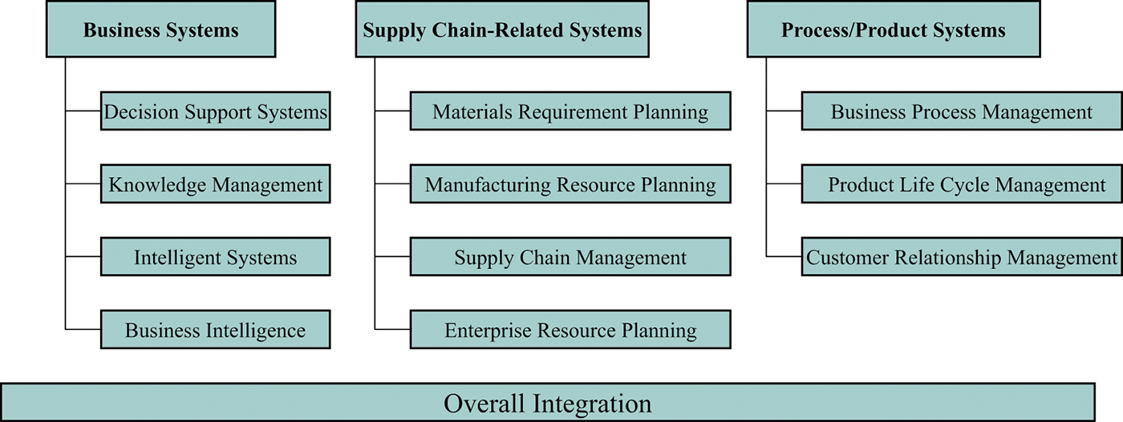
Enterprise Systems Overview

Slide 15
Knowledge
Data are a collection of:
Facts
Measurements
Statistics
Information is organized or processed data that are:
Timely
Accurate
Knowledge is information that is:
Contextual
Relevant
Actionable

Slide 16
Knowledge Characteristics
Extraordinary leverage & increasing returns.
Fragmentation, leakage & the need to refresh.
Uncertain value.
Uncertain value of sharing.
Rooted in time.
What does all this predict about a CBA?
Intellectual capital (intellectual assets) is another term used for knowledge; an implied financial value to knowledge.
Notes:
Task students to bring examples of knowledge levels. For instance, airport manning model is an example of tacit knowledge.
According to wikipedia.org:
Tacit knowledge, people are not often aware of the knowledge they possess or how it can be valuable to others. Tacit knowledge is considered more valuable because it provides context for people, places, ideas, and experiences.
Explicit knowledge is knowledge that has been or can be articulated, codified, and stored in certain media. It can be readily transmitted to others.
Goal of knowledge management is for an organization to be aware of individual & collective knowledge so that it may make the most effective use of the knowledge it has.

Slide 17
Explicit Knowledge
Explicit knowledge (or leaky knowledge) deals with objective, codified, and documented actionable and relevant information.
Data
Policies
Procedures
Software
Documents
Products
Strategies
Goals
Mission
Core competencies
The more knowledge is made explicit, the more economically it can be transferred.

Slide 18
Tacit Knowledge
Tacit knowledge is skills, ideas, and experiences that people have in their minds.
It can be difficult to articulate verbally.
It includes things like:
Insights
Acumen
Expertise
Know-how
Trade secrets
Skill sets
Learning of an organization
The organizational culture
Tacit knowledge is generally slow and costly to transfer and can be plagued by ambiguity.

Slide 19
Knowledge Transfer Mechanisms
D
I
S
S
E
M
I
N
A
T
I
O
N
B
R
E
A
D
T
H
E-mail
Shared
data
bases
M
a
n
y
Rules, procedures & directives
Manuals &
reports
Modular integration
Communities
-of-interest
Group
-ware
Communities
-of-practice
Internal
consultants
Training
seminars
&
courses
Data
exchange
Video
conferencing
Personnel
transfer
Meetings
On-the job
training
Informal
visits
F
e
w
Fax
Telephone
Low (know-how &
contextual kn..)
High (explicit
kn.. & information
ABILITY TO CODIFY

Slide 20
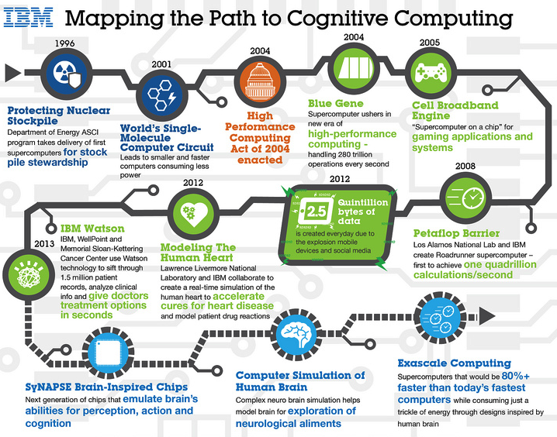
IBM’s Watson

Slide 21
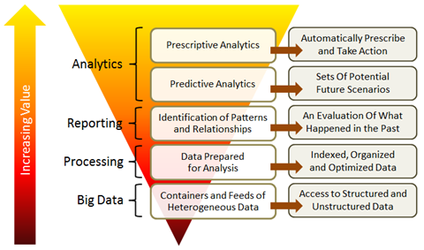
The nature of the challenge

Slide 22
Data mining
Using computers to identify hidden patterns in large data sets and to build models from this data
Models based on:
Customer segmentation and market basket analysis.
Marketing and promotion targeting.
Collaborative filtering and customer churn.
Fraud detection, financial modeling, hiring and promotion.
Prerequisites
Organization must have clean, consistent data.
Events in that data should reflect trends.

Slide 23
ARTIFICIAL INTELLIGENCE
Computer software that seeks to reproduce or mimic human thought, decision making, or brain functions
Data mining has its roots in AI.
Neural network: Examines data and hunts down and exposes patterns, in order to build models to exploit findings.
Expert systems: Leverages rules or examples to perform a task in a way that mimics applied human expertise.
Genetic algorithms: Model building techniques where computers examine many potential solutions to a problem.
Modifies various mathematical models that have to be searched for a best alternative.

Slide 24
Machine learning
Leverages massive amounts of data so that computers can act and improve on their own without additional programming
Neural networks and other types of AI play a role in machine learning, but what’s special is that computers themselves examine data, find insights, and improve.
Example:
Self-driving car

Slide 25
Machine Learning 101
Shivon Zilis – Venture Capitalist - Bloomberg Beta
Your takeaways?

Slide 26
Machine Learning 101
Shivon Zilis – Venture Capitalist - Bloomberg Beta
The World of Work is transforming at an unprecedented rate, and a large part of that is due to advances in data and machine intelligence.
Our approach is to look for signs that a startup has a chance to be extraordinary
Do users love this product?
Users tell others how to use it.
Are customers willing to pay full price?
Is there an exclusive path to customers and good timing?

Slide 27
Machine Learning 101
Machine Intelligence Landscape
Categories
Agents
Autonomous Systems: Air, Ground, Sea, Industrial
Enterprise: Security, HR, Sales, Marketing, Support, Internal Intel, Market Intel
Platforms: Research, Full Stack, Machine Learning, Industrial IoT, Audio, Vision, Data Enrichment
Industries: Adtech, Agriculture, For Good, Retail Finance, Legal, Materials & MFG, Healthcare, Education, Transport & Logistics, Investment/Finance
Tech User Tools: Data Science, Machine Learning, Open Source

Slide 28
Machine Learning 101
Mike Del Balso – Head of Machine Learning Implementation, Uber
Your Takeaways?

Slide 29
Machine Learning 101
Mike Del Balso – Head of Machine Learning Implementation, Uber
Trying to bring machine learning and intelligent machines to every aspect of decision-making.
Build a model that predicts your destination.
There are a billion cars on the road now, and 96% of them are not being used at any time.
Multiple riders in single car, challenges the very idea of car ownership.
Best route for the driver to take.
Understand who are the best drivers.

Slide 30
Machine Learning 101
Nick Adams – Managing Director, AME Cloud Ventures
Your Takeaways?

Slide 31
Machine Learning 101
Nick Adams – Managing Director, AME Cloud Ventures
Big Data is Forecast to be a US $24 billion industry in 2018 and most of that data will come from machine learning.
We love technology-heavy companies that gather or create unique data at every step.
What problem is the company trying to solve?
What is the business they are trying disrupt?
What is the business model and how is it differentiated?

Slide 32
Machine Learning 101
Jerry Kaplan – Fellow, Dept of Computer Science, Stanford University
Your Takeaways?

Slide 33
Machine Learning 101
Jerry Kaplan – Fellow, Dept of Computer Science, Stanford University
The most important thing to recognize with respect to Artificial Intelligence is that it is a technology, not a market.
AI must be incorporated into products and services.
With the progress made in Machine Learning, the most productive places to apply it are to any industry or problem for which there is a lot of data available, but not in a standardized form.
Widespread mythology that we are building increasingly-intelligent machines that may ultimately surpass human capabilities – and wreak havoc. Narrative is misguided and counterproductive.
AI is simply a natural extension of our long-standing effort to automate tasks.

Slide 34
What’s Driving the Machine Learning Explosion?
Three Factors in Play
What are they?

Slide 35
What’s Driving the Machine Learning Explosion?
Three Factors in Play
Enormously increased data
Significantly improved algorithms
Substantially more-powerful computer hardware

